Slide 1

School Management System
Dha Lhamu Lama
NCC ID: 00171890

Slide 2
Introduction
School management system is a software that handles the activities of the school.
Built with the use of PHP language with its framework called Laravel.
Backend Laravel
Frontend built with the bootstrap with its framework like html, css.
Database is separately done with use of mysqli to store the details of school
Xampp is installed and used for the system since it is necessary to open the website

Slide 3
Problem statement
School without this software is having big problem in managing the daily details of school activities. Problems were
Difficult to understand how to manage the students
Problem in finding the details of anything of school whenever needed
Problem in communication with teacher

Slide 4
Background of project
Software company with prestige that provides best results.
Customer satisfied
Already built software like school before
Software made mainly for school
User friendly software.
Won values to its services since the clients user are happy with its product.

Slide 5
Aims and Objectives
Aims
To meet the requirements of the school
To analyze the details data of school that includes teacher, student, class etc.
To make admin easy in running academic process easy and fast

Slide 6
Objectives
(a) Record keeping
It maintains the data of all the student and teacher in database system.
It maintains the personal record as well as the academic record of the student.
It maintains student fee record and dues record.
Teacher personal record and salary record are also store in the software.
It also manages class record, subject record, examination record.

Slide 7
(b) Reports Generating
Reports are the essential outcomes of school management system (SMS).Reports includes the given points
Total number of student in the class
Student admission reports
Character certificate of the student
Submitted due reports
Teacher Experience reports
Examination report
Detail Marks Certificate

Slide 8
Features
Following are the main features of our project
Admin work
Crud function
Thorough Attendance
Maintaining Examination
Communication

Slide 9
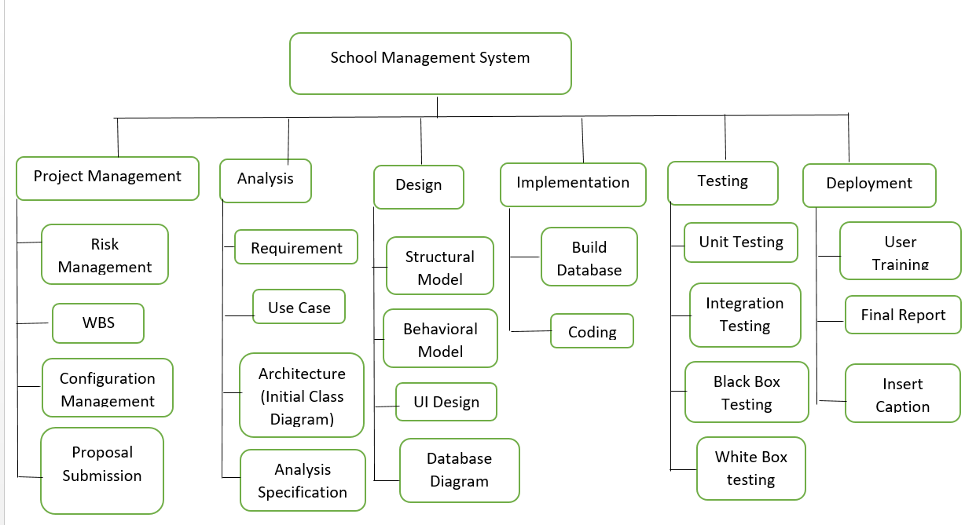
Work Breakdown system Work breakdown structure is a project management and systems where works are divided into smaller projects.

Slide 10
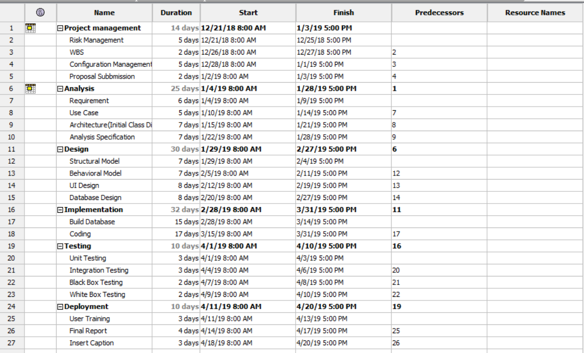
Gyantt Chart: Helps in completing the project in time which is like planning with the allocation of time.
Gyantt chart
Figure 5: Gantt chart

Slide 11
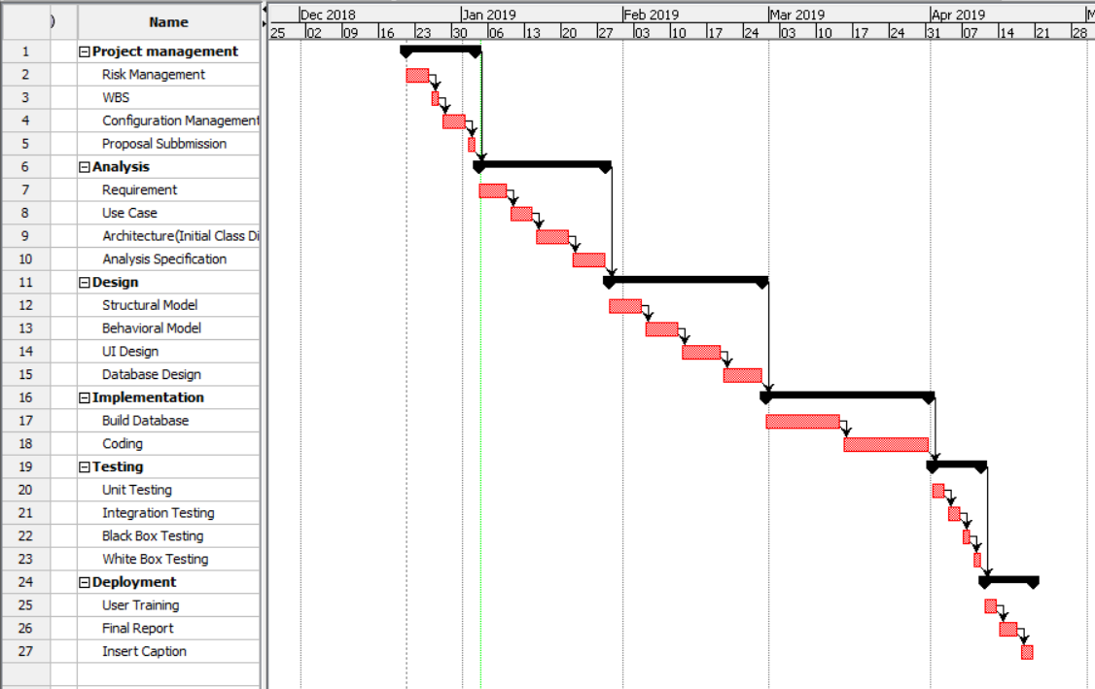

Slide 12
Methodology
Waterfall methodology is used
All the project process is done with the steps of waterfall method lik
Requirement gathering
Design
Implementation
verification
Maintenance

Slide 13
Architecture
3-tier system architecture is used
Presentation Layer
Logic Tier
Data Tier

Slide 14
Risk management
Risk Management is the process of identifying, evaluating, and the prioritizing of the risks seen in the management. Risk can be controlled by the given points below
Identify the reason of risks
Understand who gets harmed and how
Follow the steps of evaluating the risks and follow precautions measures
review the project risks and update if needed

Slide 15
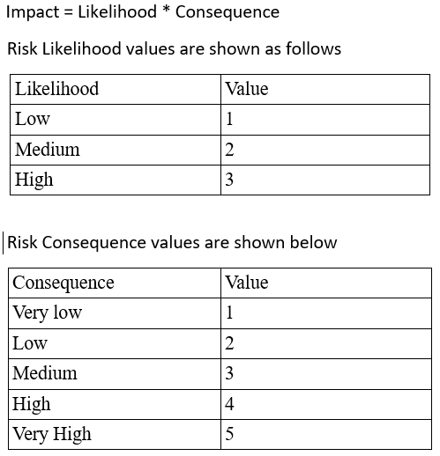

Slide 16
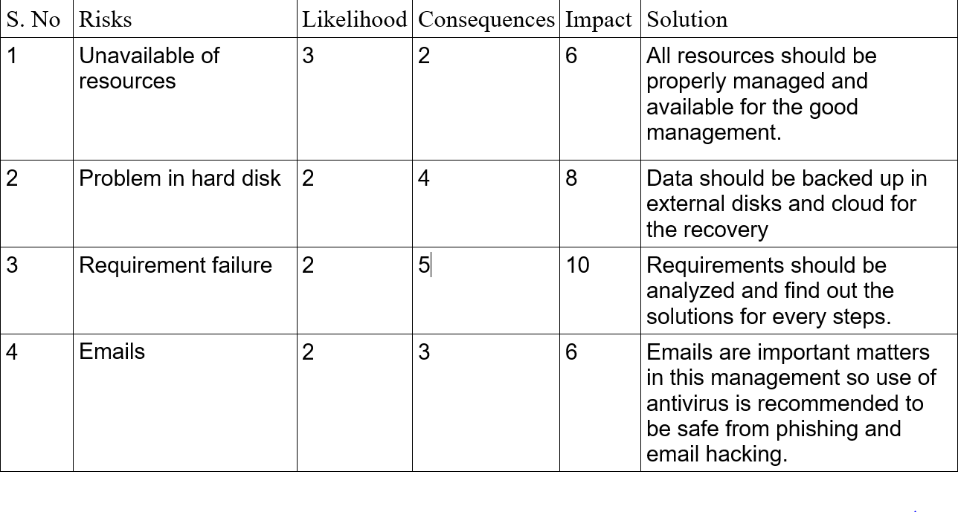
Risk are evaluated on the basis of following table

Slide 17
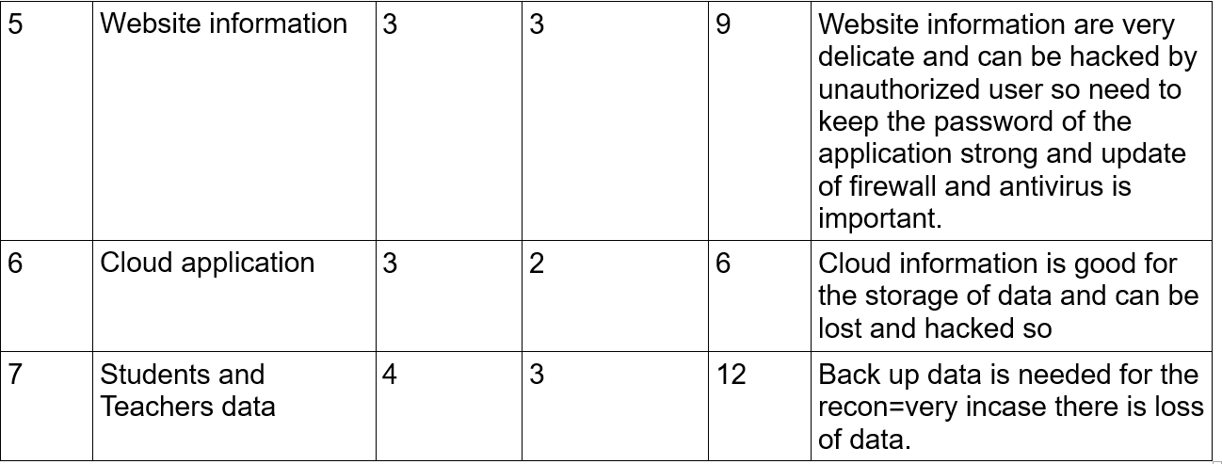

Slide 18
Design
Design is of two types
Structural and behavioural
Structural(usecase, er diagram)
Behavioural(activity, sequence)
School management system designed the given diagrams
Use case: A use case diagram is a graphic depiction of the interactions among the elements of a system.

Slide 19
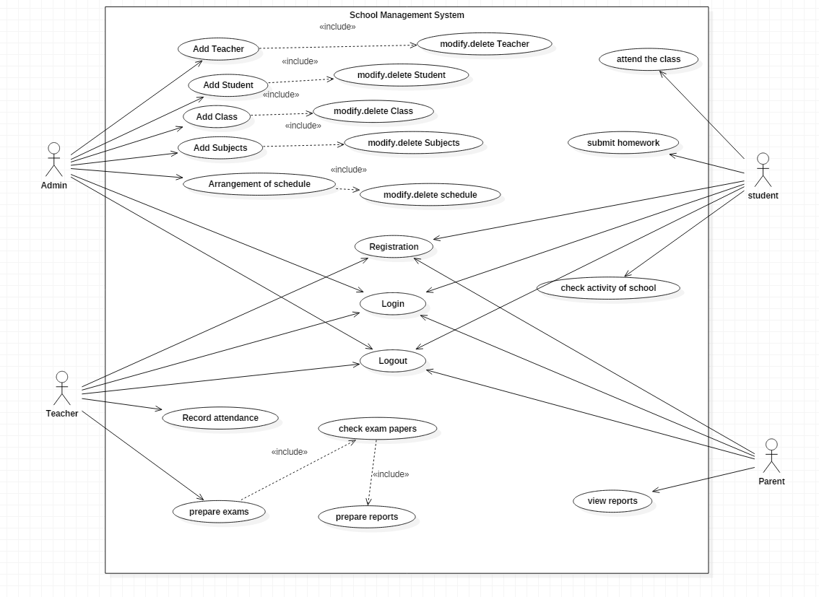
Use case for school management system

Slide 20
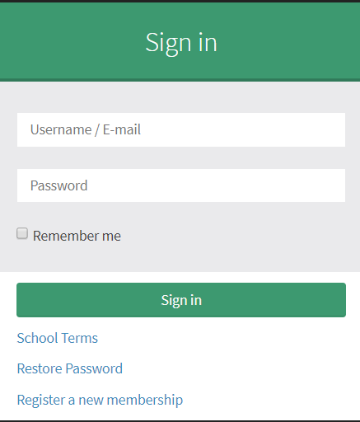
Coding and UI

Slide 21
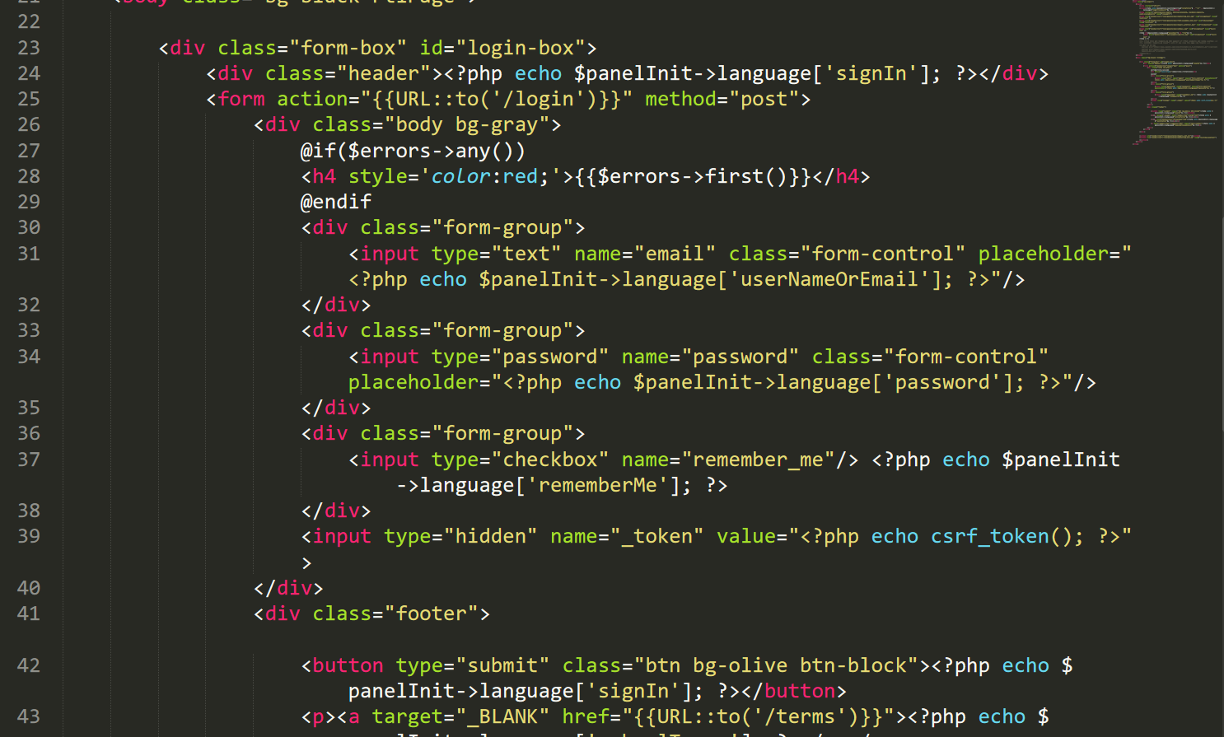

Slide 22
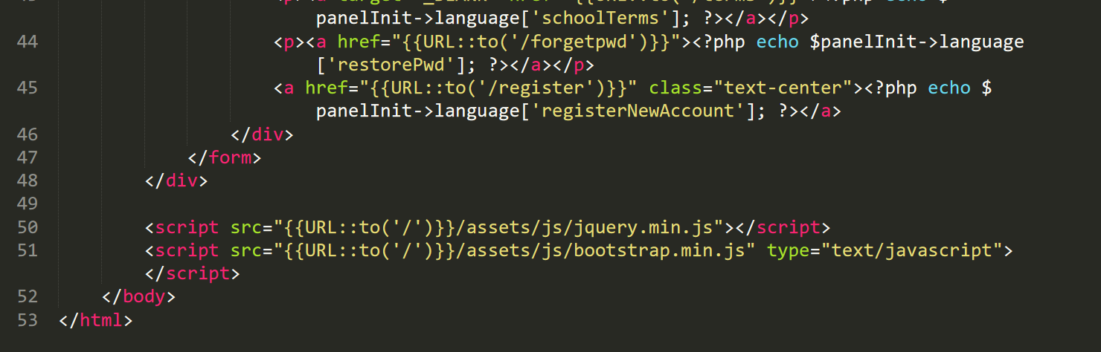

Slide 23
Test cases
I have tested the project in two ways. Black box testing and white box testing.
Black box testing is also known as behavioral testing that checks the internal part of the project but the tester wont understand
White box testing is also known as structural testing that checks the internal part of the project but the tester will understand.

Slide 24
Future work
Future work are as follows for my school management system
Online school management system is one of my future work
Student can pay through online their fees
Teacher can easily get paid through online.

Slide 25
Limitations
If the system crashes this application will be corrupted.
Backend can be accessed for the storage but there is limit in storage.
It is not online software.
This application can be used only by school management

Slide 26
User manual

Slide 27
conclusion
Finally, with the use of Laravel framework of the PHP and Xampp with database, I am able to complete the website for the school. The school is user friendly and good to use. Now, the school admin student teacher and parent can have easily access to the website and can get all the details of School. Most of the requirements of school is completed and some others parts I kept for future work.

Slide 28
References
https://www.workbreakdownstructure.com/
https://en.wikipedia.org/wiki/Configuration_management
https://www.tutorialspoint.com/mvc_framework/mvc_framework_introduction.htm/
https://laravel.com/
https://startbootstrap.com/

Slide 29
The end
Thank you

